Slide 1

Final Project Data 606 Bike Rentals
Marjete Vucinaj
May 15, 2023

Slide 2
Abstract
Bike rentals have increased in the past few decades as a mean of transportation. This helps reduce traffic, carbon emissions and is beneficial for riders’ health.
The goal of this project is to determine if temperature predicts quantity of bike rentals. To investigate this, a bike share dataset, from Washington DC, containing temperature and bike rental quantity data was analyzed using regression analysis.
The result of this analysis shows a strong linear relationship (R squared of 39%) between temperature and number of bike rentals, specifically, as the weather is warmer, the number of bike rentals increase.
It is more important than ever that city planners continue to update infrastructure and ensure bike lanes are accessible in more neighborhoods. Additionally, bike rental companies should closely monitor their supply of bike gear in warmer months. Business’ can also leverage data like this project to update their subscriptions or offer free wintertime referrals.

Slide 3
Overview
The Bike Sharing Data Set was obtained from UCI Machine Learning Repository and is a observational study.
The company, Capital Bike Share, publishes their data each quarter, and the researchers aggregated the data and added the corresponding weather information.
The data has 731 observations representing number of days in 2011 and 2012.

Slide 4
Overview
Research question: Does the temperature predict the quantity of daily bike rentals?
The dependent variable is the count of daily bike rentals
The independent variable is the temperature, this variable is normalized or rescaled so the range of these values is between 0-1

Slide 5
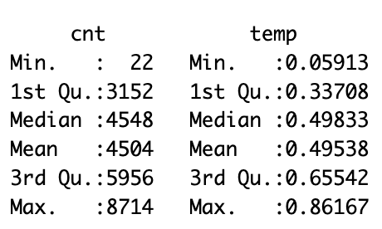
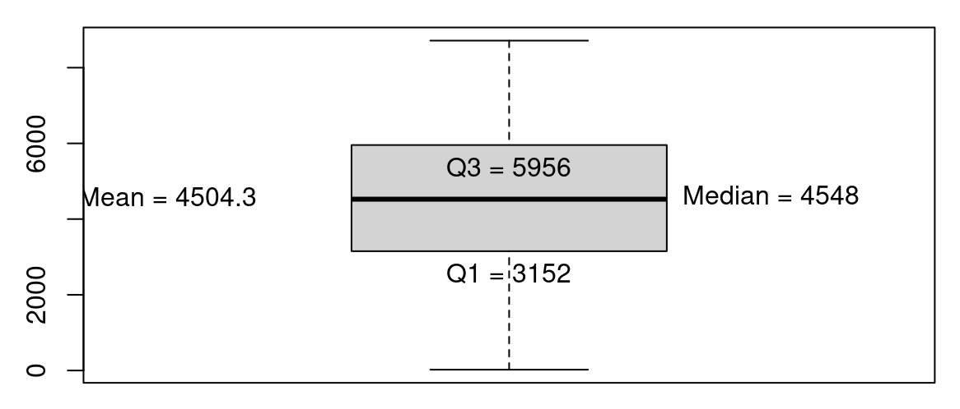
Summary statistics
Box plot of Count Data

Slide 6
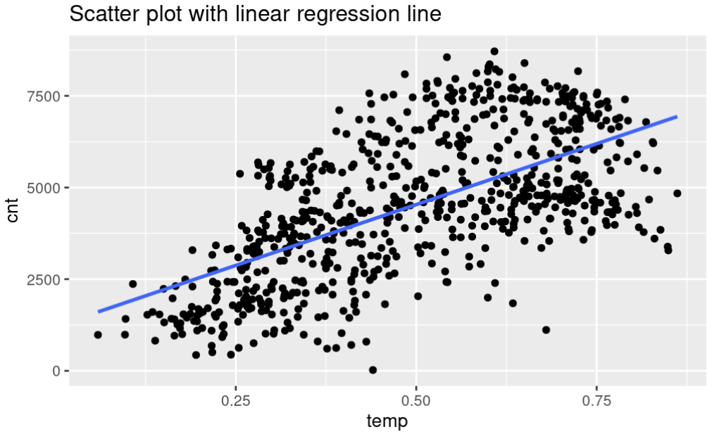
Data visualizations

Slide 7
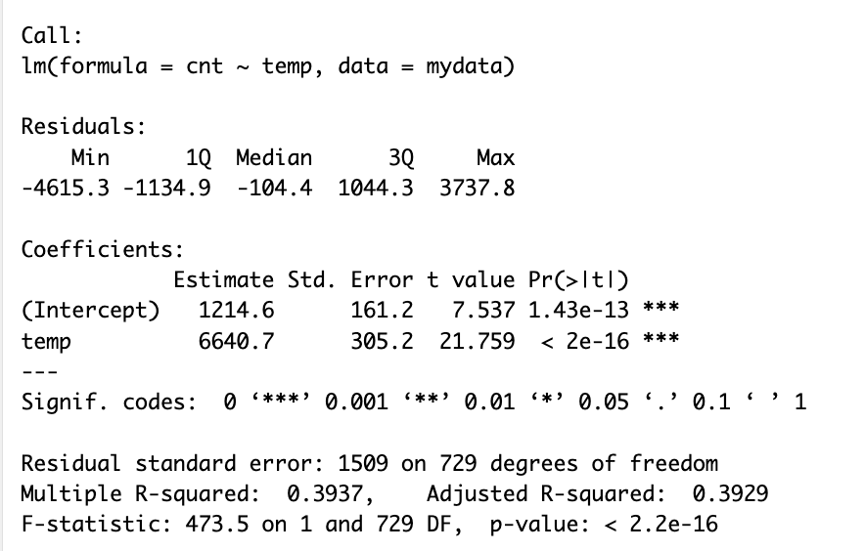
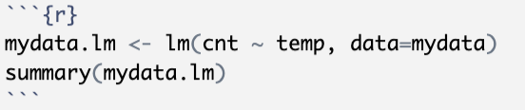
Statistical output
R squared is 0.39, meaning my model accounts for 39% of the variability of temperature predicting number of bike rentals

Slide 8
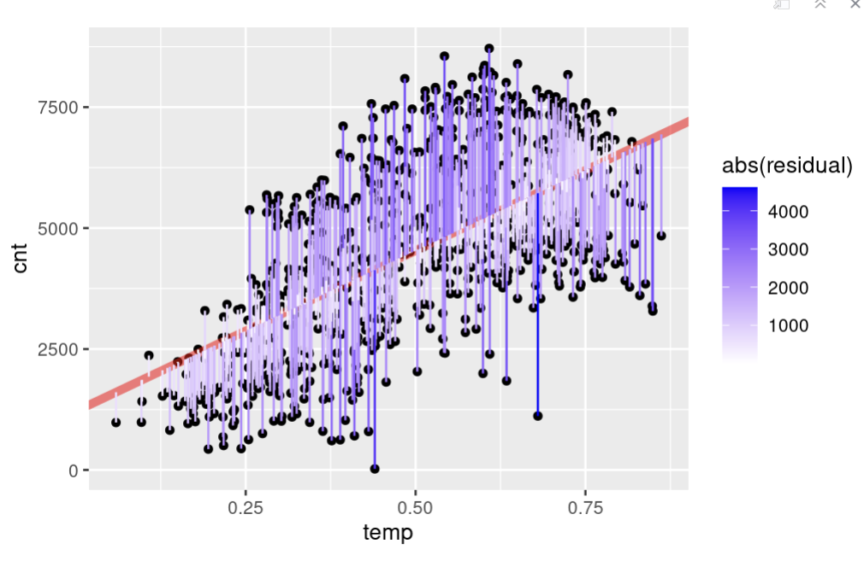
Statistical output
To assess whether the linear model is reliable, we need to check for
linearity,
(2) nearly normal residuals, and
(3) constant variability.
Scatter plot with residuals

Slide 9
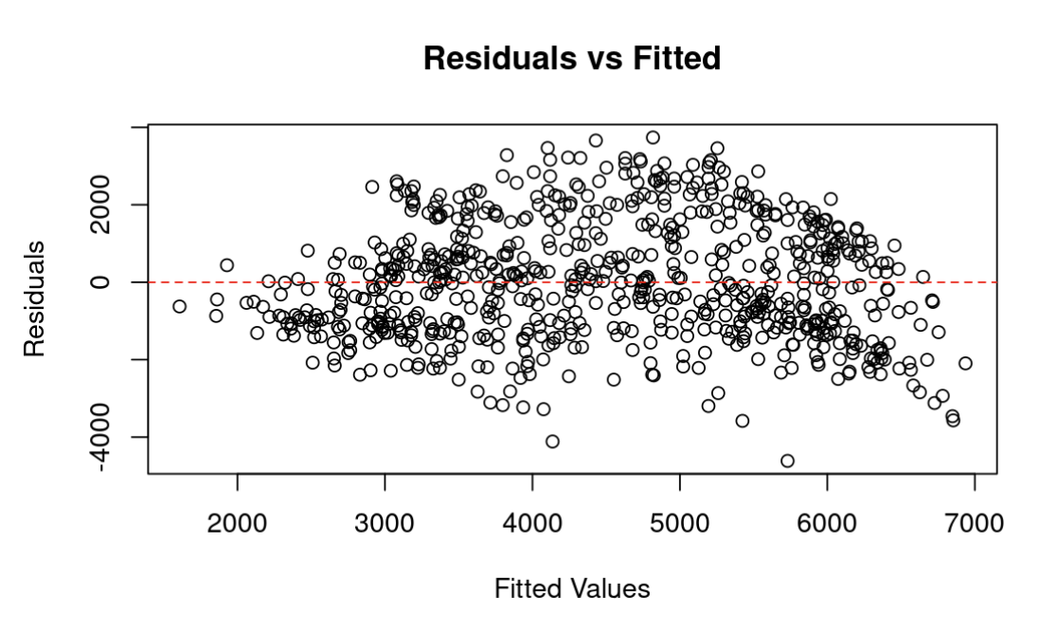
Statistical output
Condition of constant variability is met as there is no pattern around the zero, suggesting a linear relationship.

Slide 10
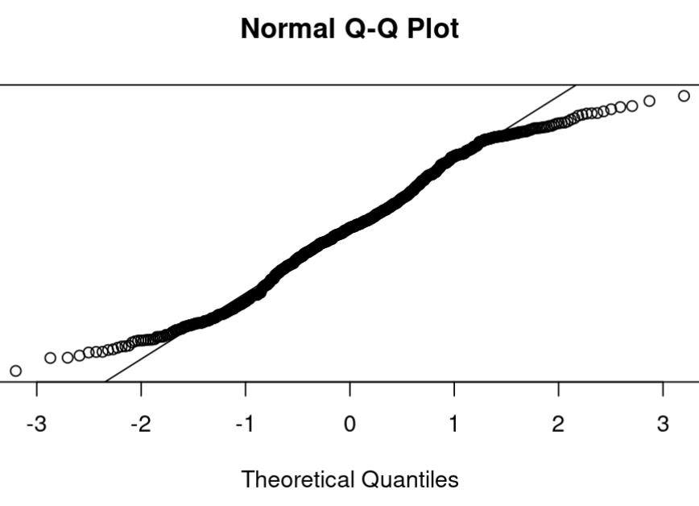
Statistical output
The normality assumption can be confirmed with qqplot as most points do not deviate from line.

Slide 11
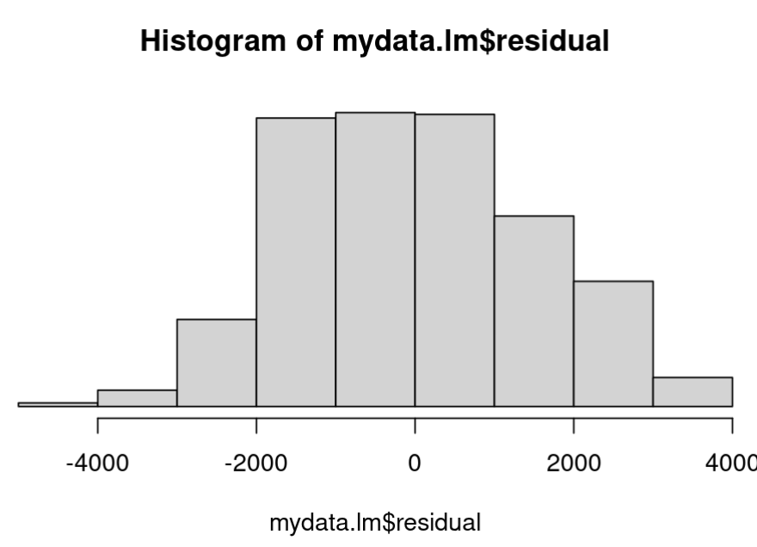
Statistical output
The histogram of residuals look close to a normal distribution. It has a left skew.

Slide 12
Conclusion
39% of my model suggests that temperature predicts number of daily bike rental.
Importance: As bike rentals have become a more common mode of transportation, it is ideal to examine the factors that encourage one to rent a bike.
- It is helpful for city planners to know which neighborhoods have a high bike rentals to ensure bike lanes are accessible.
- Companies can ensure they have adequate supply of biking gear especially in warmer weather.
- While casual users can rent a bike with most companies, businesses’ typically make more profit with subscription-based models.
Hypothetically casual users can receive reduced price subscription for the winter/ colder months to increase company revenue

Slide 13
Conclusion
Limitations: One of the limits of this analysis is the data itself being 11 years old at this point.
Future steps would be to utilize a multiple regression model with current data to investigate if other variables can more strongly predict count of bike rentals.
Additionally, I would want analyze the categories of ‘registered users’ and ‘casual users’ to better understand how these categories impact the linear regression.

Slide 14
References
Source: Hadi Fanaee-T, Laboratory of Artificial Intelligence and Decision Support (LIAAD), University of Porto, INESC Porto, Campus da FEUP, Rua Dr. Roberto Frias, 378. 4200 - 465 Porto, Portugal
Thank you!!

